Slide 1


Slide 2
Enterprise iOS apps, no app store required!

Slide 3




Enterprise iOS apps, no app store required!
Ian Barker
Embarcadero Delphi MVP
ian.barker@gmail.com
@punctuation
about.me/IanBarker
Slides, link & replay: https://tinyurl.com/iosenterprise22

Slide 4
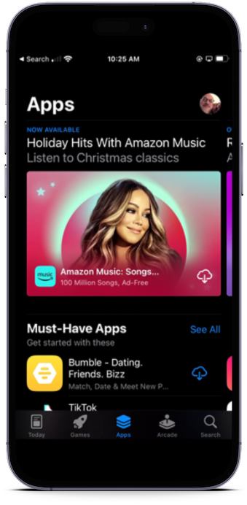
The Apple App Store?
Love it or hate it the Apple App store is the ‘walled garden’ of curated apps which have passed Apple’s approval process
Unlike Windows and Android there is no other way to get apps onto iOS devices…

Slide 5
The Apple App Store?
…or is there? 😁

Slide 6

The Apple App Store?
…or is there? 😲

Slide 7
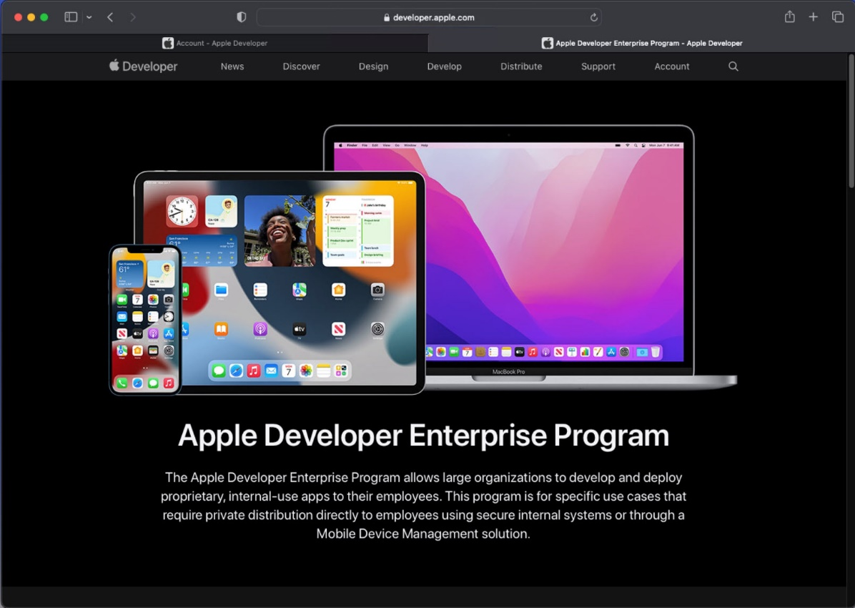
Apple Enterprise Apps
There is an Apple Developer Enterprise Program
Does not use the normal Apple app store
Costs money to join, paid yearly
Companies are verified by Apple

Slide 8
What is the Apple iOS Enterprise Program?
A scheme which allows companies to develop in-house iOS apps for use by their own staff and contractors
Costs money to join, paid yearly
Companies are verified by Apple

Slide 9
What is the Apple iOS Enterprise Program?
Apps are distributed either directly to company-curated devices
Or via a specially-written web page

Slide 10
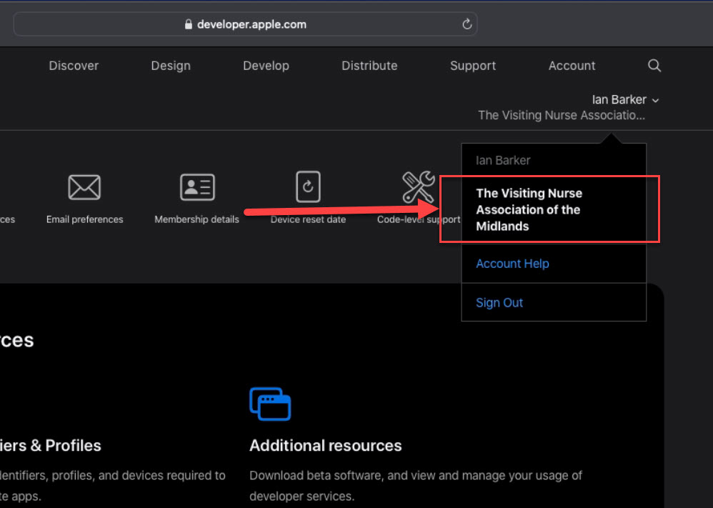
What is the Apple iOS Enterprise Program?
Developers are either in-house
Or external contractors
The developers join the Enterprise’s “team”

Slide 11
Why would you want to do this?
If you are a developer it allows you to create apps for corporate customers
It can be very lucrative – more so than the app store!
Development labor, consultancy
Technical support, training, repeat business!
No royalties to Apple ☺
No approval process, no guidelines either

Slide 12
Is selling via the app store profitable?
The standard app store commission is 30%
There is also a small business program of 15% if you earn less than $1m per year
https://www.apple.com/newsroom/2020/11/apple-announces-app-store-small-business-program/
Compare to Enterprise membership at $299 per year

Slide 13
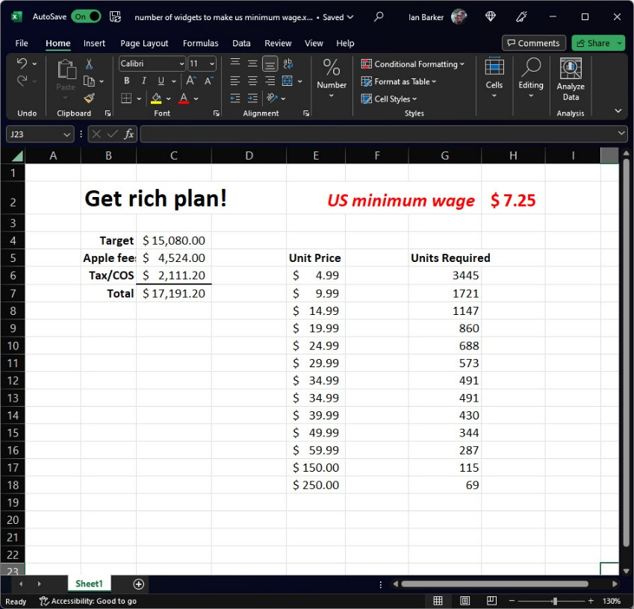
Is selling via the app store profitable?
Compare the regular app store to how much you would earn on the US minimum wage
You would have to sell 3445 copies of your app to make the same as minimum wage 😢

Slide 14
How are iOS Enterprise apps distributed?
Email
WIFI
iTunes
Enterprise provisioning-tools
Specially-crafted web page
Updates are super-easy: code it, sign it, distribute it

Slide 15
What’s the difference between an Enterprise app and a ‘normal’ app?
An Enterprise app is an application that has been signed using an Apple Enterprise Certificate
It’s usually ‘ad-hoc’
However, it’s not tied to any specific devices
…and yes we can create them in Delphi, C++ and RAD Studio

Slide 16
What do you need?
The company or organization needs to be registered with the Apple Enterprise Developer program
https://developer.apple.com/programs/ios/
$299 per year
Company must provide a D-U-N-S number
http://www.dnb.com/get-a-duns-number.html
Someone with ‘legal authority’ for the organization must validate the paperwork

Slide 17
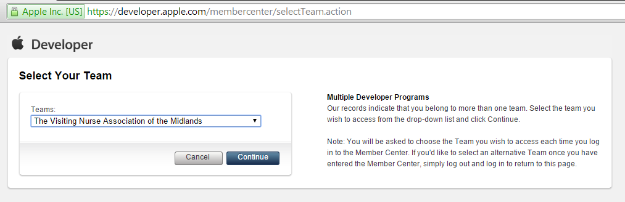
Sign on to the development portal
Use the Apple ID associated with the Enterprise program
https://developer.apple.com/membercenter/index.action

Slide 18
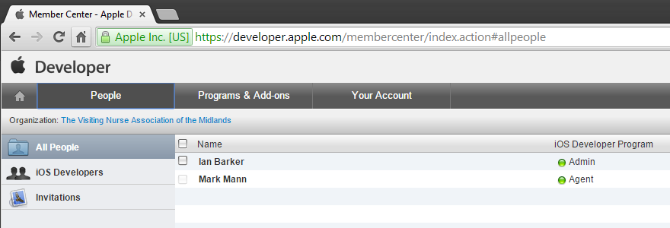
Assign developers and roles to the team
If you are a developer working on behalf of an Enterprise customer then the team “Agent” needs to assign your Apple ID to the team

Slide 19
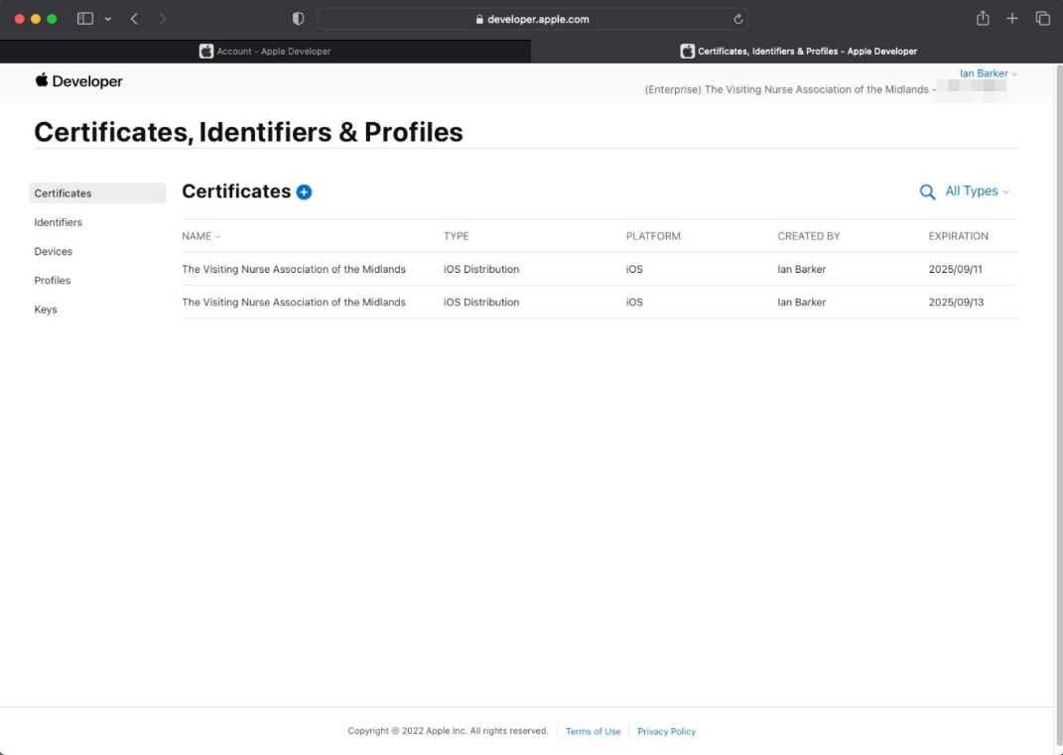
There are several signing certificates to produce
You will need at least
An iOS Distribution Certificate for the enterprise
A development certificate for the developer
Provisioning profiles for the app or apps
You need to note these down!

Slide 20
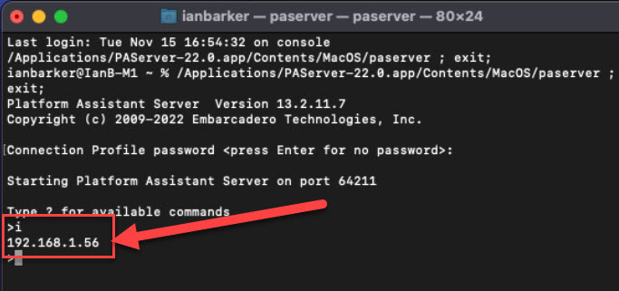
You will also need XCode and the correct SDK
Install PA Server if you haven’t already

Slide 21
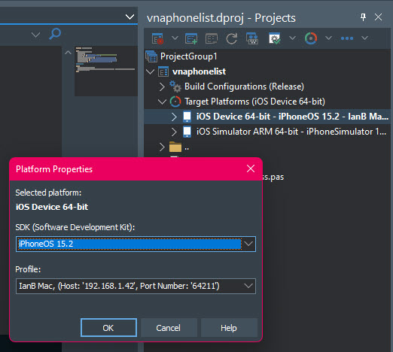
Make the connection just as you do for any other iOS app
Set the correct platform properties

Slide 22
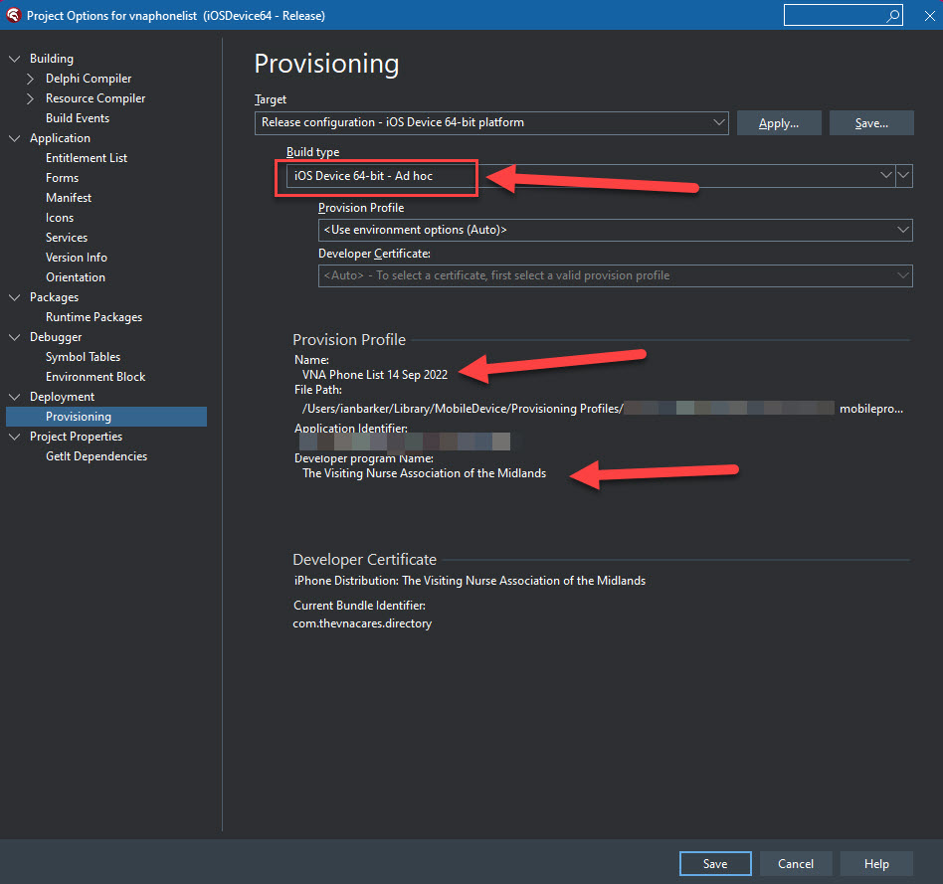
If everything is set up correctly you should find RAD Studio locates and selects your Enterprise provisioning profile and distribution certificate
Choose iOS Device 64bit – Ad hoc

Slide 23
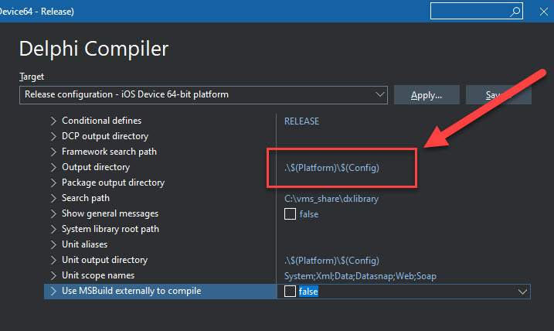
This is controlled on the project’s compiler options page
Where can you find the .IPA package?

Slide 24
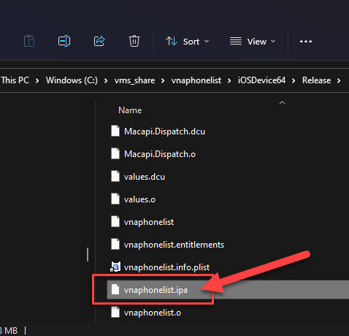
This should be the .IPA file after successful compile and deployment
Where can you find the .IPA package?

Slide 25
Distribution of your iOS Enterprise apps
Test Flight
https://testflightapp.com
MDM Apple’s Enterprise Management tool http://www.apple.com/iphone/business/it/management.html
A special web page link

Slide 26
Using a ‘magic’ html link
<html>
<body>
<a href="itms-services://?action=download-manifest&
url=https://www.yourwebsite.com/a_folder/appname.plist">
Click here for the app</a>
</body>
</html>

Slide 27
Creating a .Plist file for app on the website
Go to here
https://tinyurl.com/iosenterprise22
You need the following files
.mobileprovision
.IPA file
A 57x57 PNG file for an icon
.PLIST file
Web server must support https

Slide 28
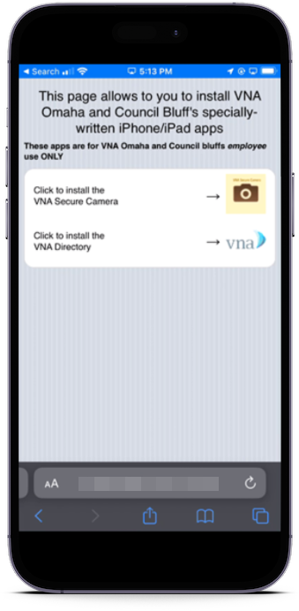
No app store required No Apple approval
The Enterprise users can simply go to the web page to install

Slide 29
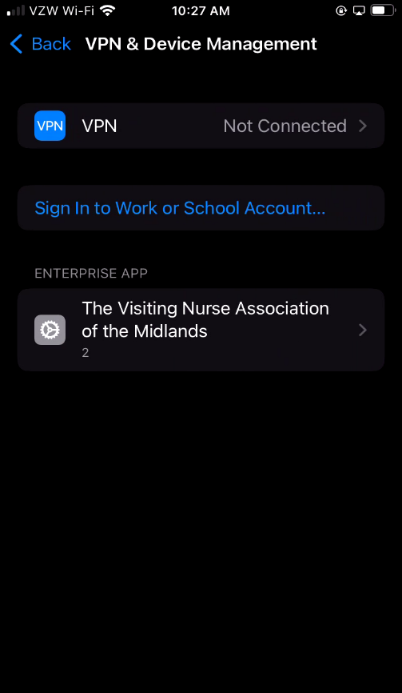
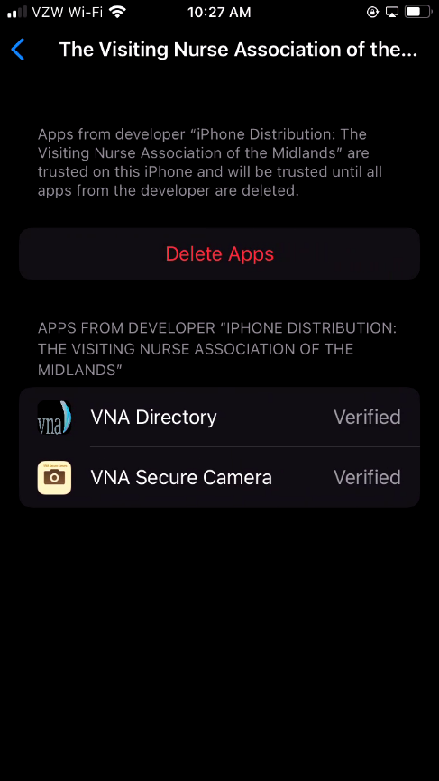
The Enterprise users will need to install the provisioning profile of the registered Enterprise

Slide 30
Tips
Put some analytics on the web page
Secure the web page
Have a “not available” page suitable for mobile
Make the web page simple
Include some sort of update mechanism or push notifications in your app
Once an Enterprise app goes out anyone with the .IPA can install it

Slide 31
Useful links
https://tinyurl.com/iosenterprise22
http://aaronparecki.com/articles/2011/01/21/1/how-to-distribute-your-ios-apps-over-the-air
http://delphi.radsoft.com.au/2013/10/creating-ad-hoc-deployments-of-ios-apps-with-delphi-part-2/
http://www.dnb.com/get-a-duns-number.html
https://developer.apple.com/programs/ios/
https://developer.apple.com/programs/ios/enterprise/

Slide 32


Thanks for watching…
Enterprise iOS apps, no app store required!
Ian Barker
Embarcadero Delphi MVP
ian.barker@gmail.com
@punctuation
about.me/IanBarker
Slides, link & replay: https://tinyurl.com/iosenterprise22

